Slide 1
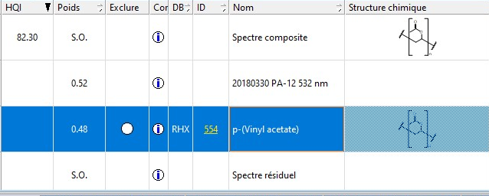
(A)
(B)
Supplementary Figure S1. Raman spectrum for an ingested microplastic fragment of 2.1µm length identified in copepods from the Seine Estuary (A) and comparaison with polymer database software (B) (KnowItAll, Biorad ®).

