Slide 1
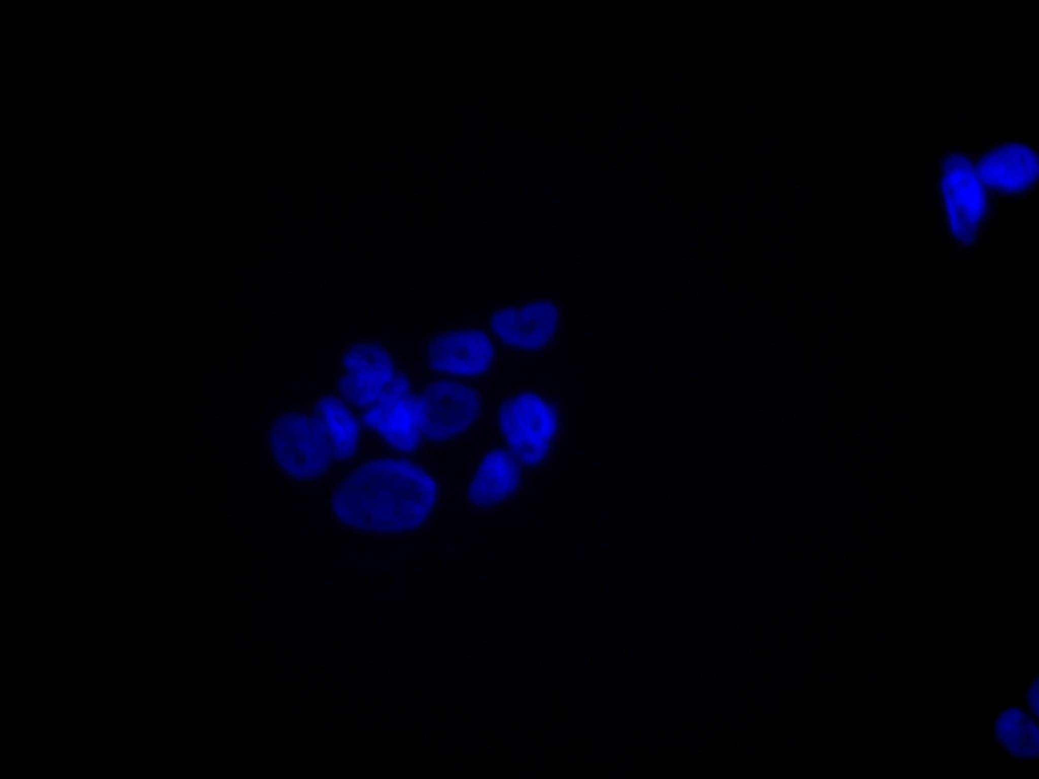
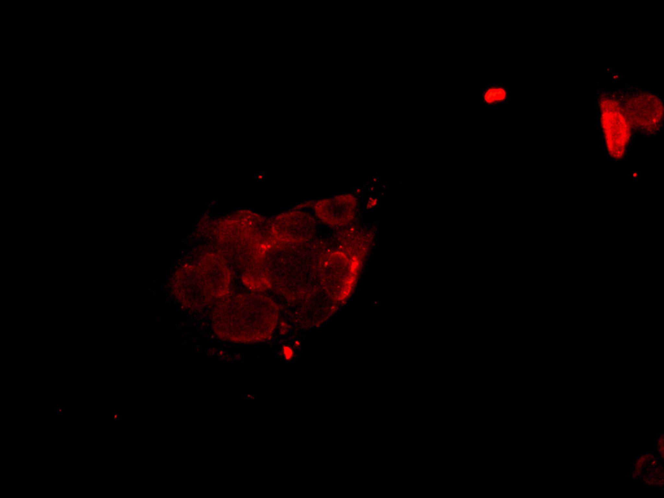
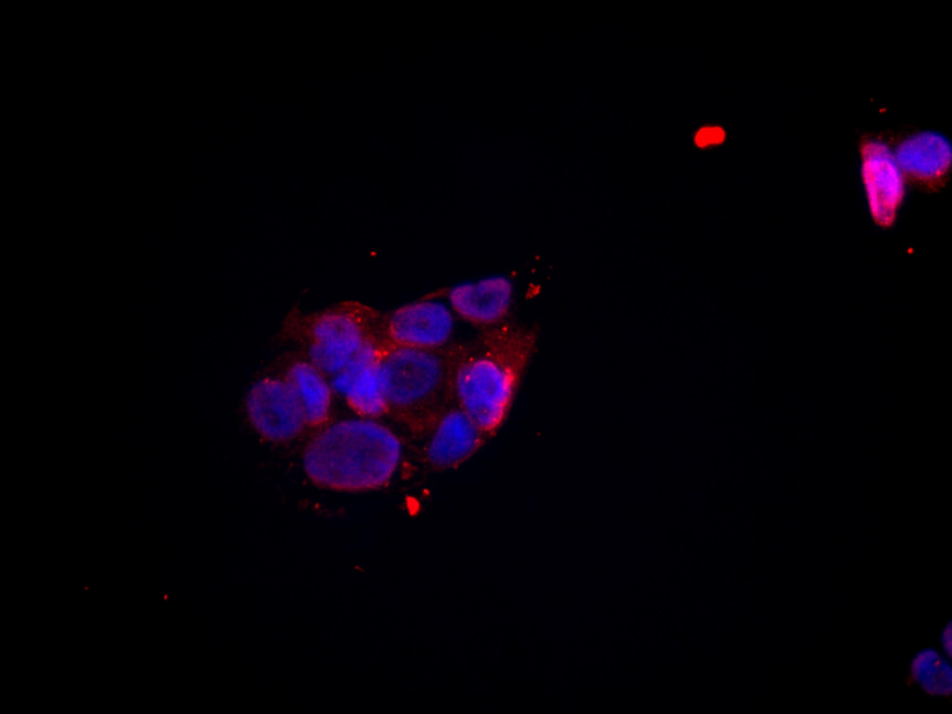
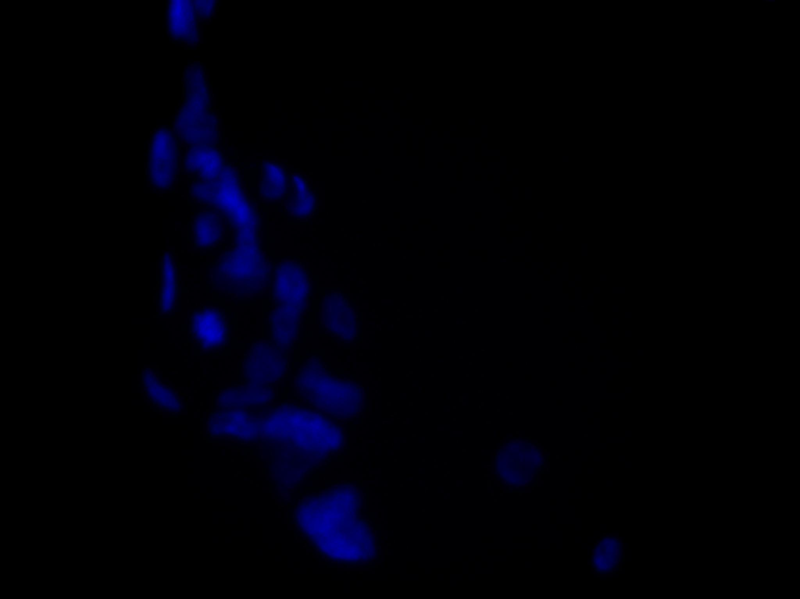
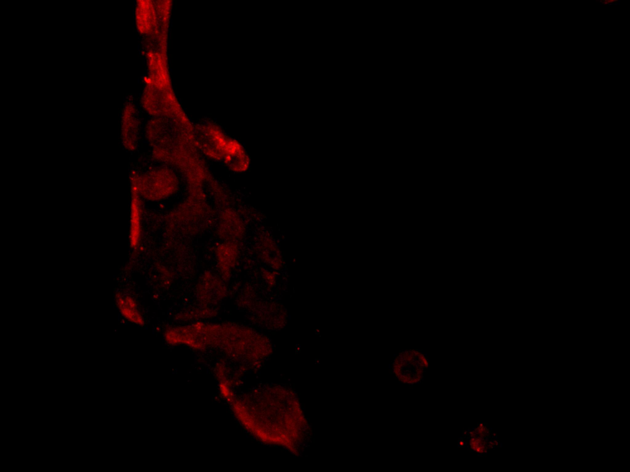
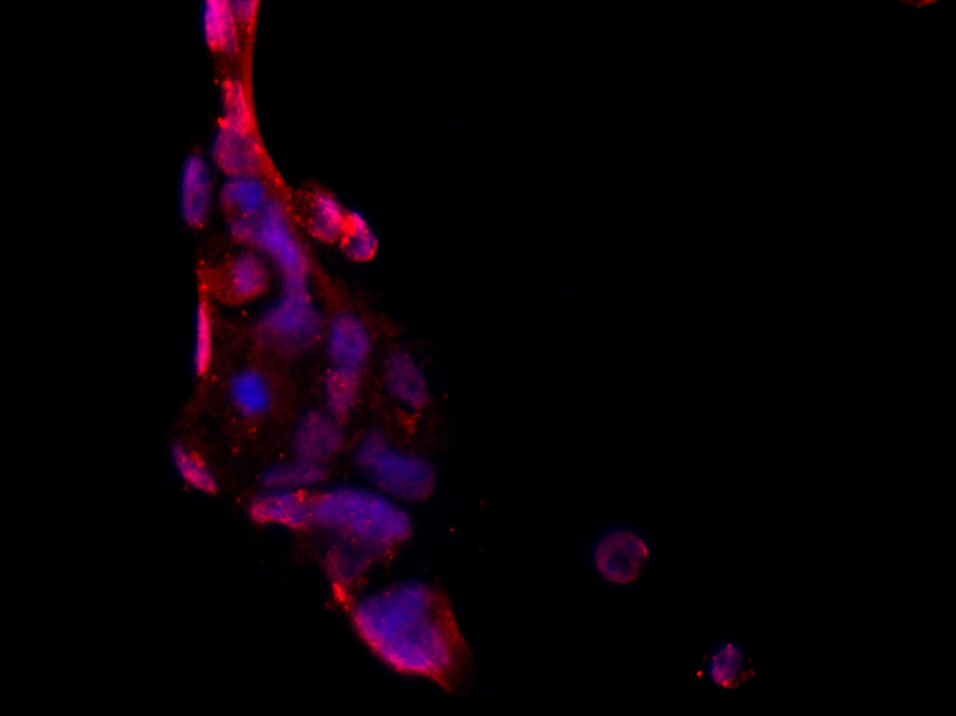
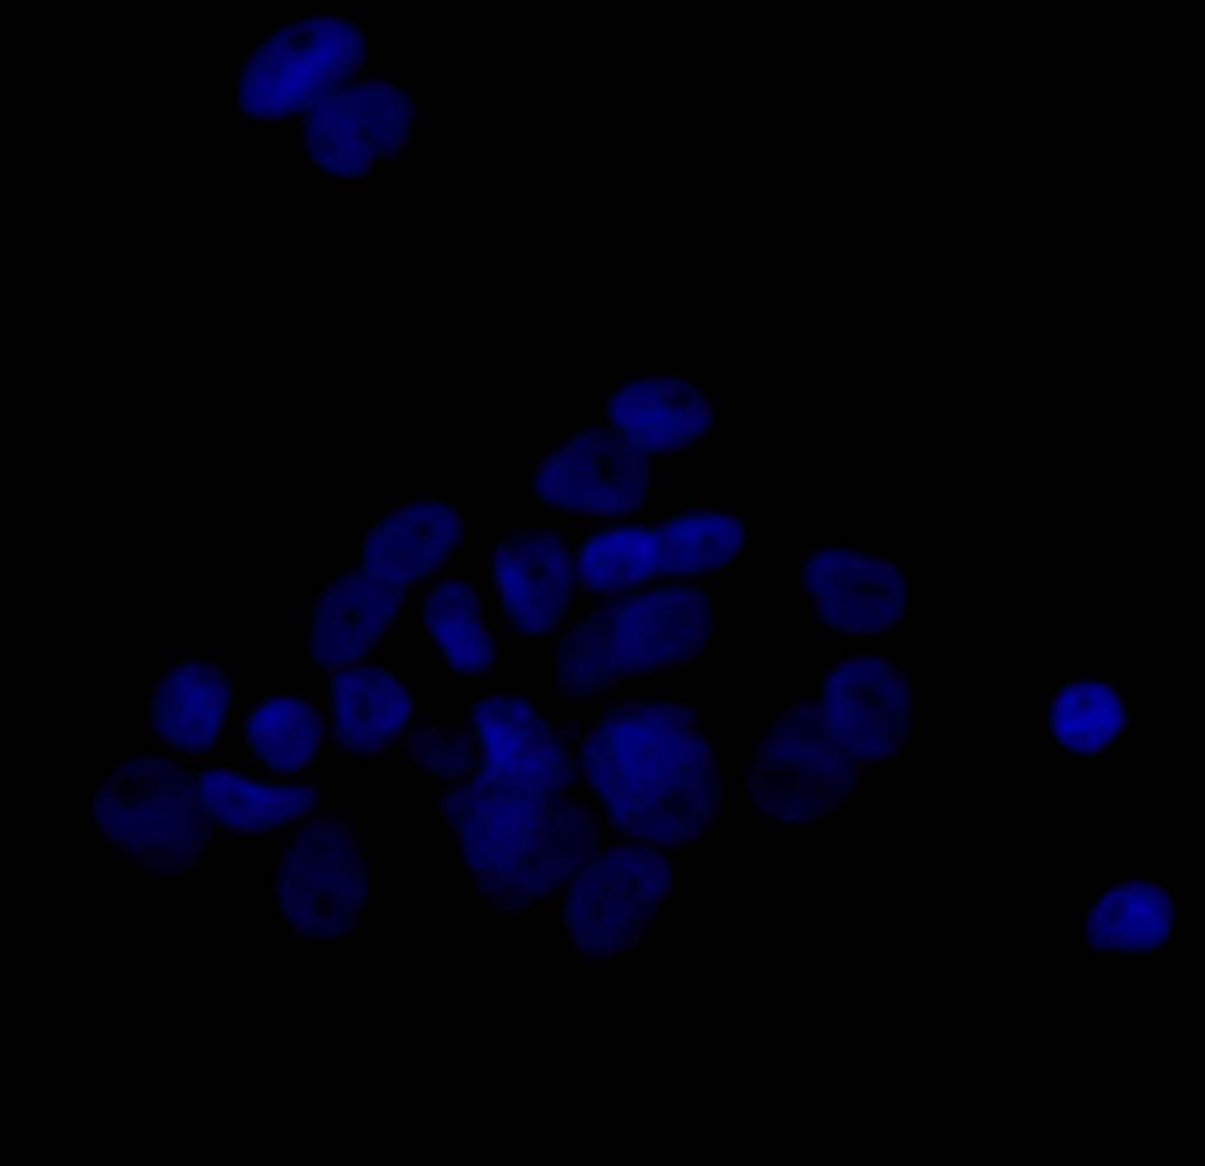
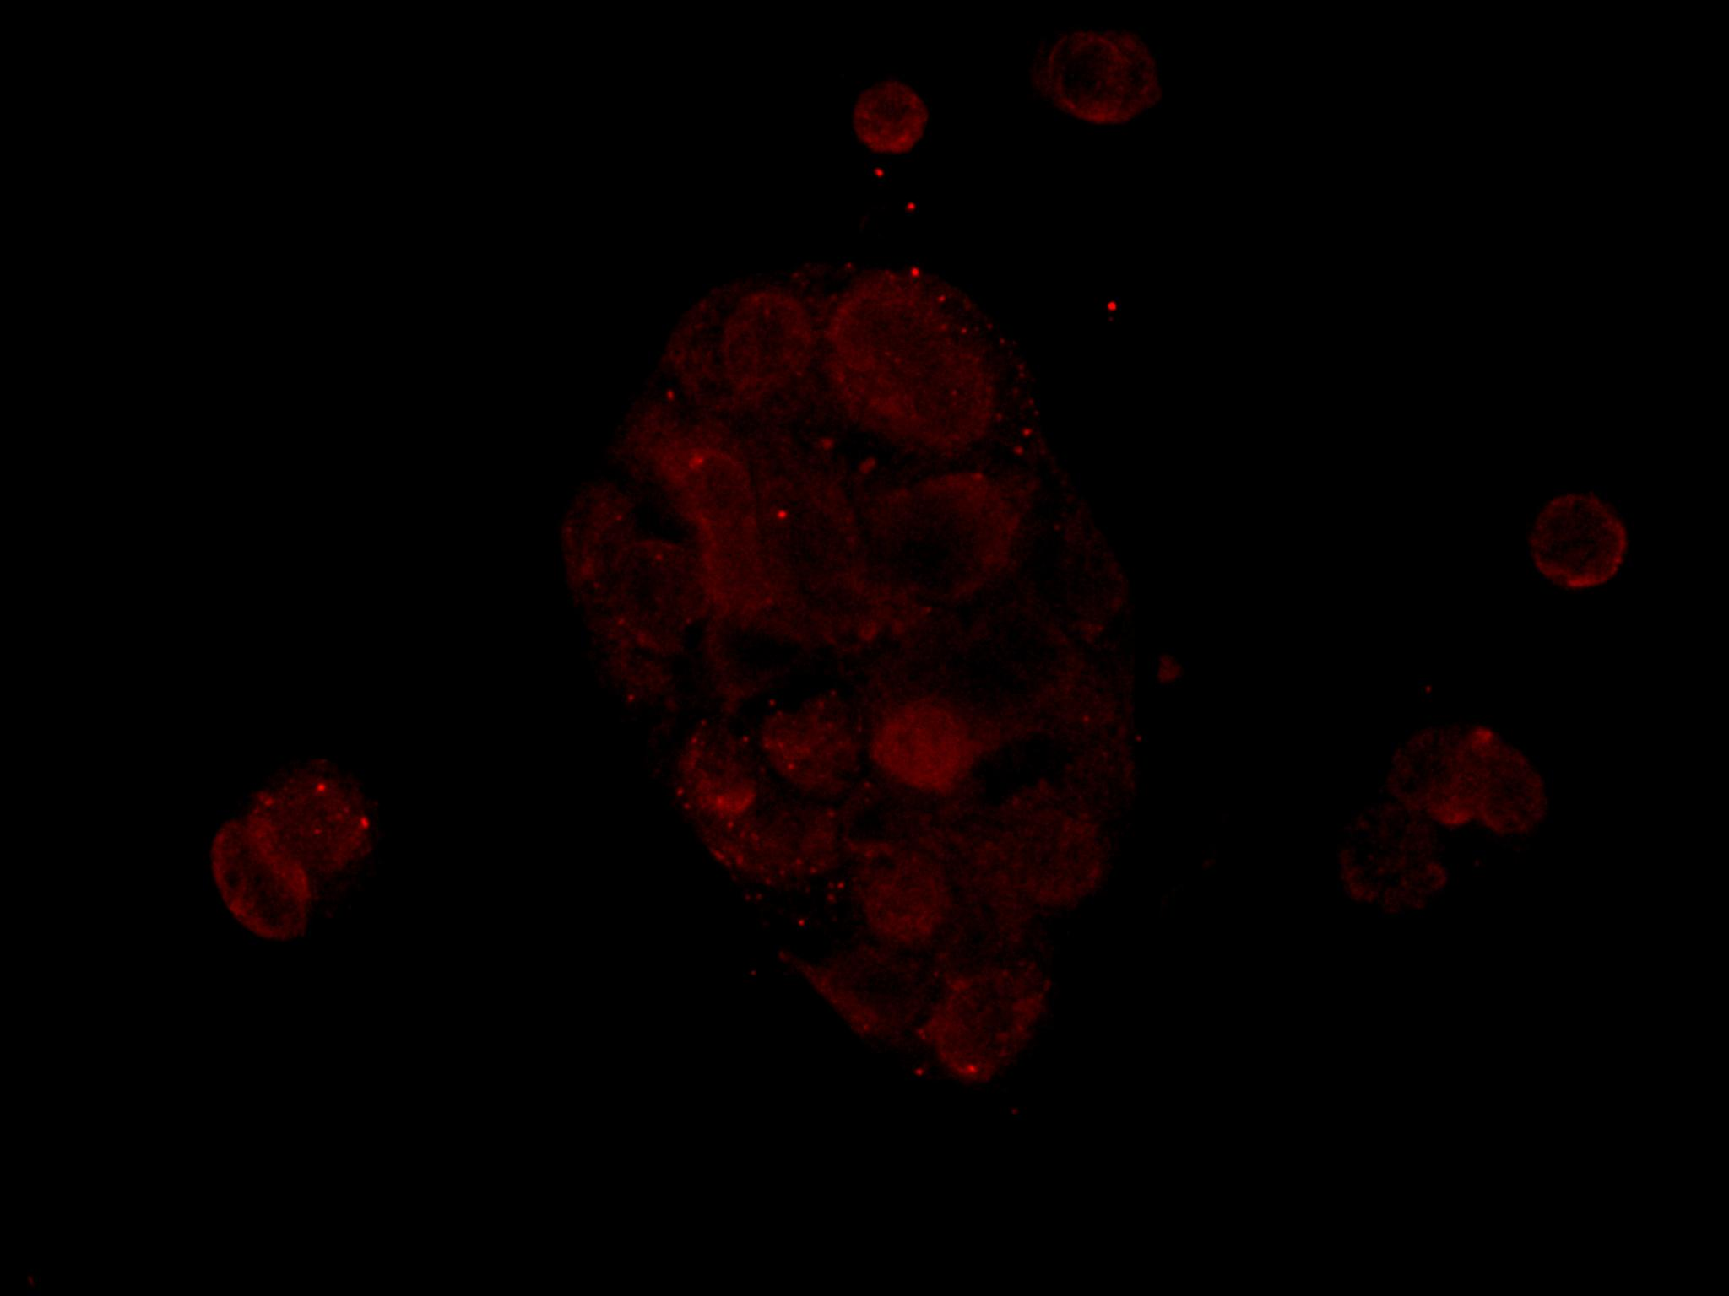
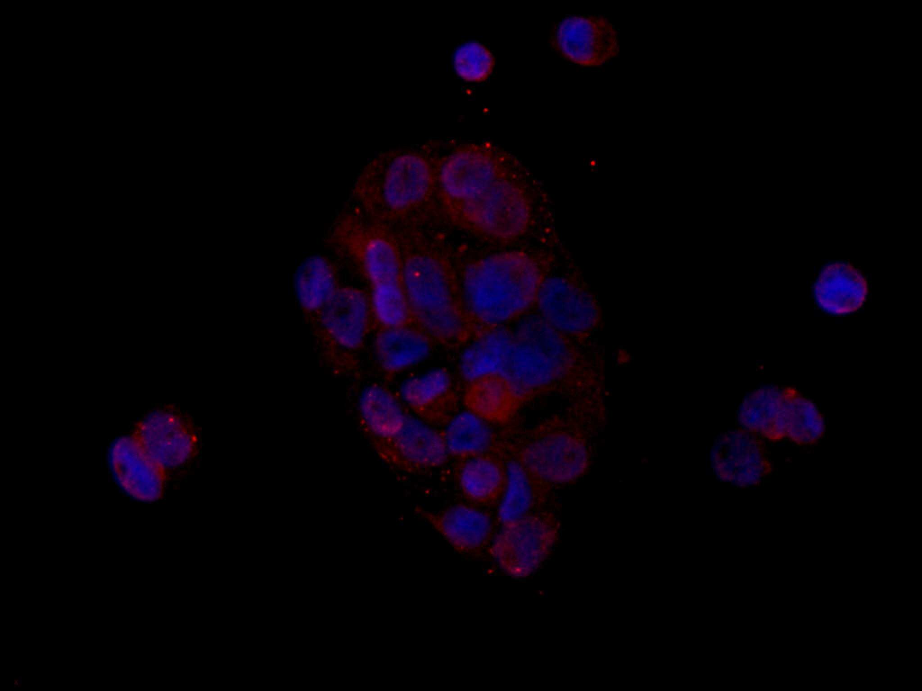
Suppl. Fig. 2
A)
B)
DAPI
TMPRSS2
MERGE
DAPI
ACE2
MERGE
Basal
Basal
R1881
R1881
10μM
10μM
Estradiol
Estradiol
Suppl Fig. 2: Representative immunoﬂuorescence experiment showing cytoplasmic localization of TMPRSS2 (red) (A) or ACE2 (red) (B) in CALU-3 cells. Cells were maintained in lipophilic hormones-free medium for 7 days, and then were treated with estradiol (10nM) or R1881 (100nM) for 30 h in CSS medium. Nuclei are stained with DAPI (blue). Scale bars, 10 µm.

