Slide 1
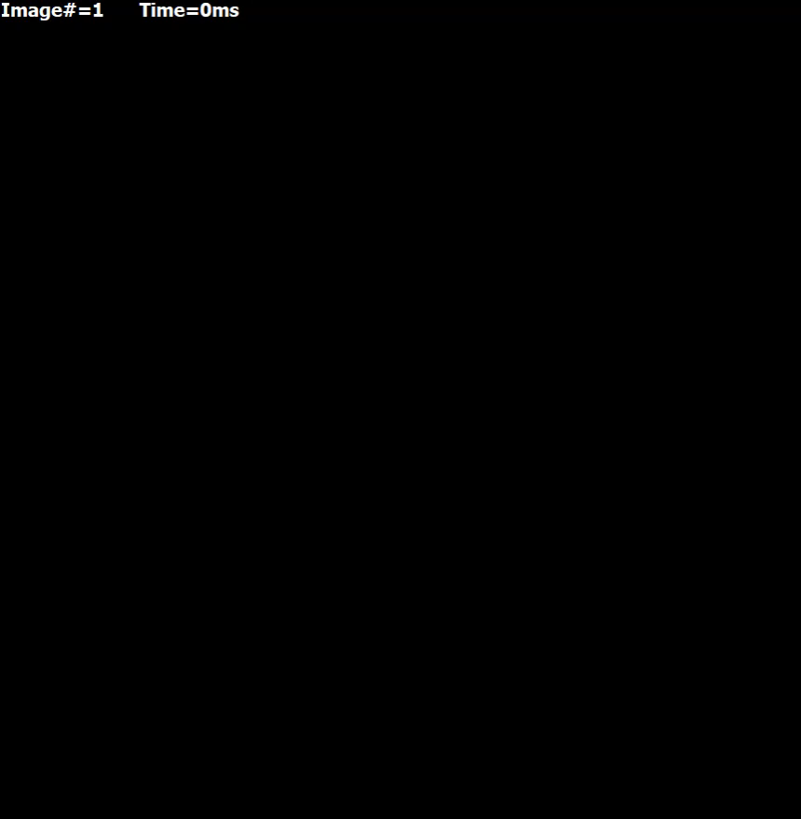
Movie 11. P_{up} = 5 mM/s, g_{CaL} ∈ [0.17, 0.57] nS/pF, mean = 0.37 nS/pF, ρ=10³ MΩ×m
Movie 12. P_{up} ∈ [0, 10], mean = 5 mM/s, g_{CaL} = 0.37 nS/pF, ρ=10³ MΩ×m
Movie 13. P_{up} = 5 mM/s, g_{CaL} ∈ [0.17, 0.57] nS/pF, mean = 0.37 nS/pF, ρ=1 MΩ×m
Movie 14. P_{up} ∈ [0, 10], mean = 5 mM/s, g_{CaL} = 0.37 nS/pF, ρ=1 MΩ×m.

