Slide 1
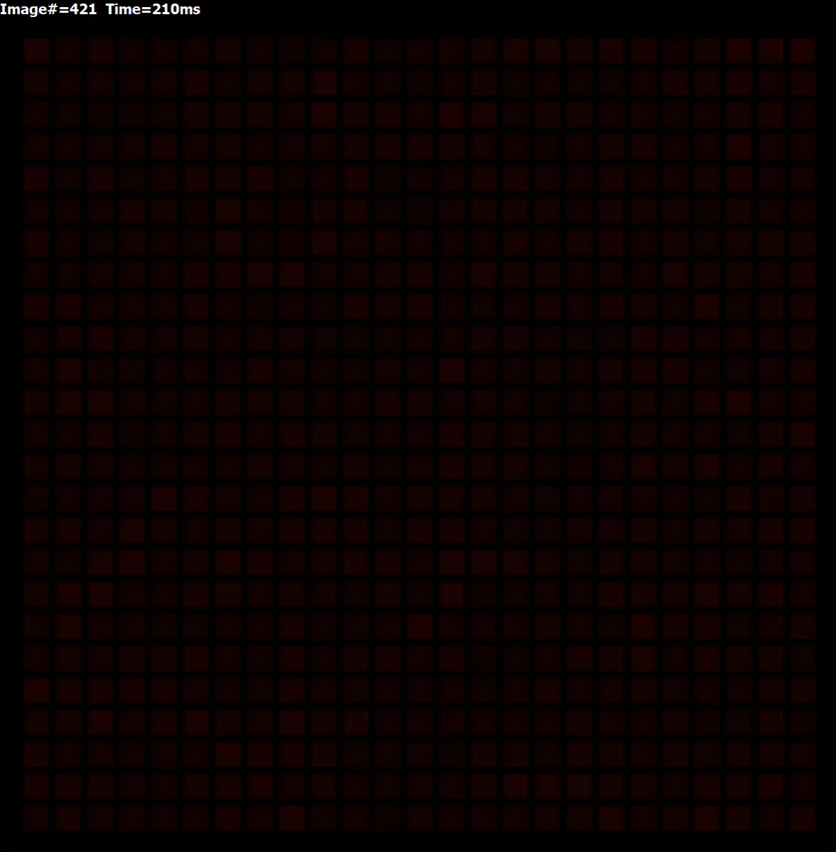
Movie 4. Pup ∈ [2, 12], mean = 7 mM/s, gCaL = 0.34 nS/pF, ρ=10⁴ MΩ×m

