Slide 1
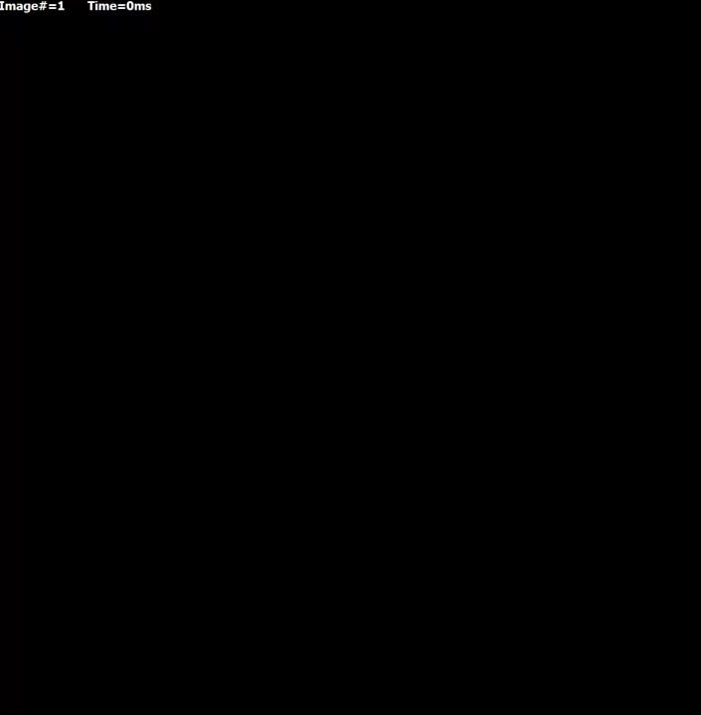
Movie 3. Pup = 3 mM/s, gCaL ∈ [0.21, 0.61] nS/pF, mean = 0.41 nS/pF, ρ=10⁴ MΩ×m

