Slide 1
Figure S1. PPI Network of the genes regulated after capsaicin treatment

Slide 2
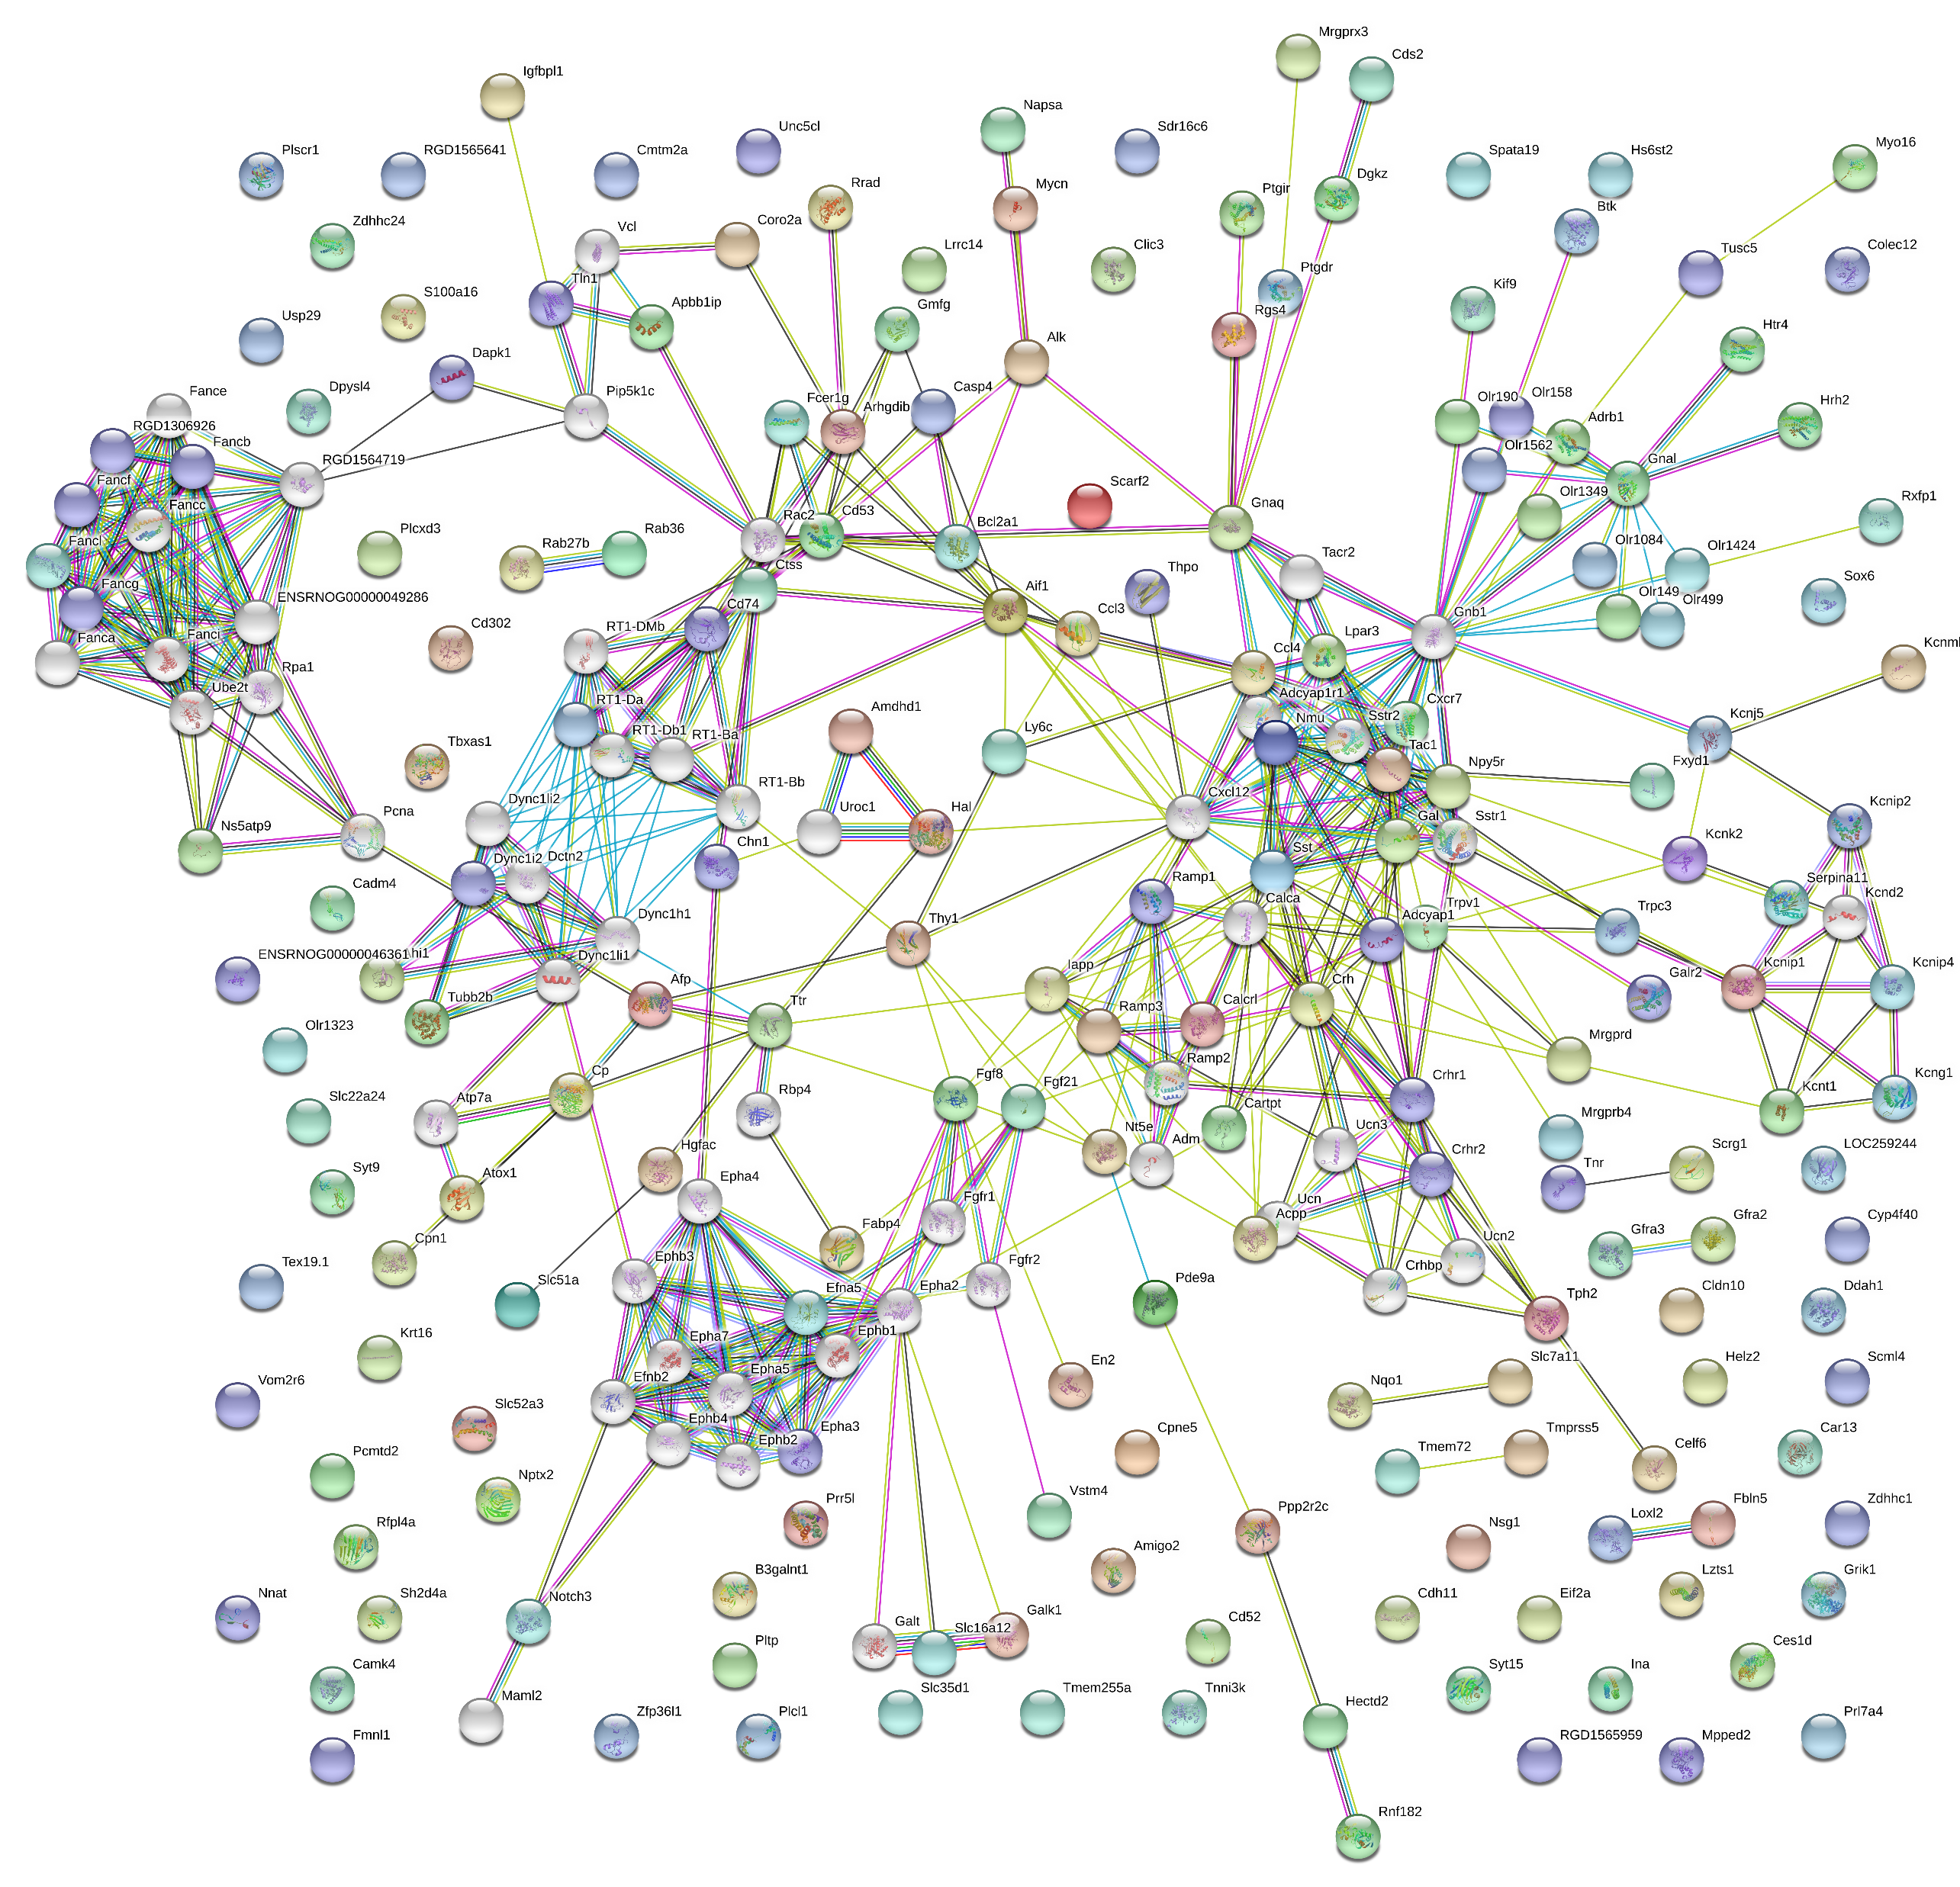
Figure S2. PPI Extended Network of the genes regulated after capsaicin treatment

Slide 3
Figure S3. PPI Network of the genes regulated after RTX treatment

Slide 4
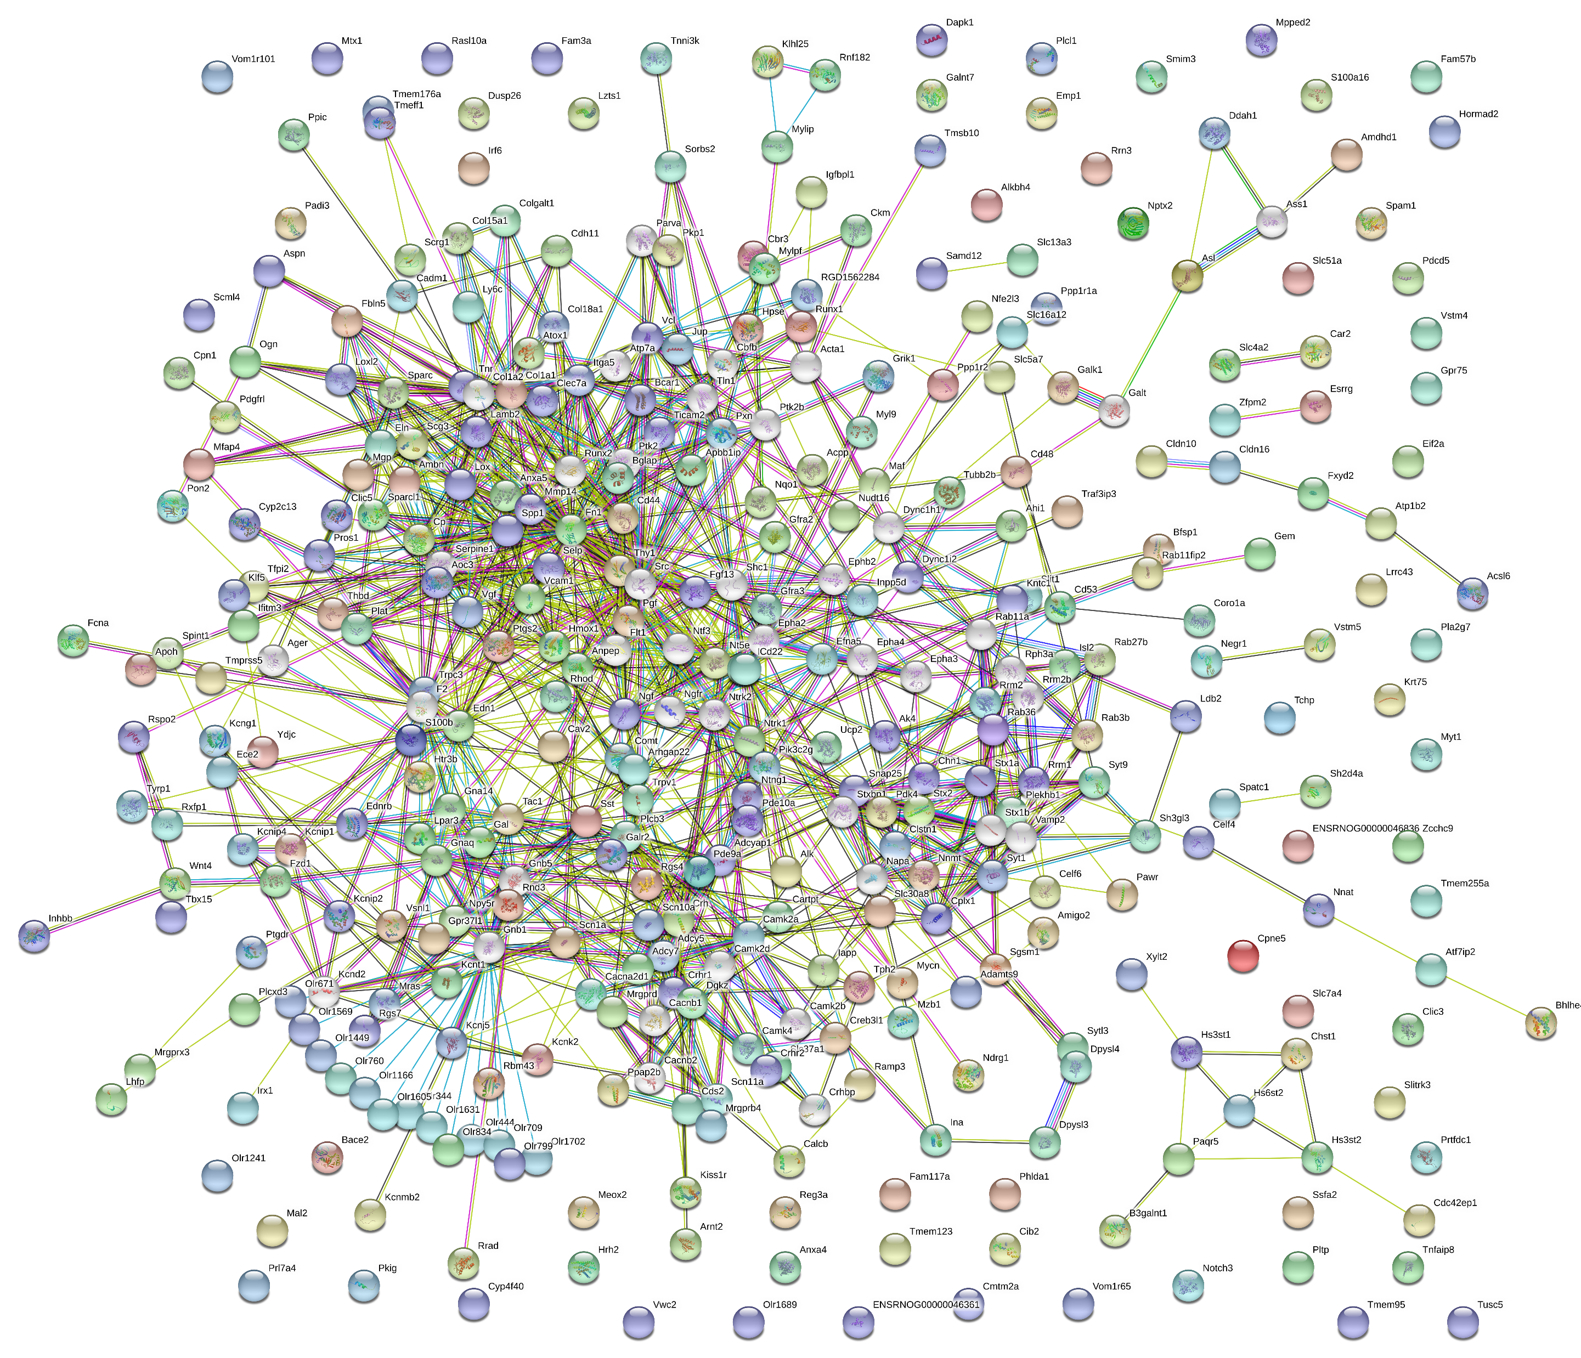
Figure S4. PPI Extended Network of the genes regulated after RTX treatment

