Slide 1
1000
Methanol
Ethanol
800
2-Propanol
Butanol
600
Specific activity (mU/mg)
400
200
0
Lxmdh
Bmmdh
Bsmdh
Cnmdh
Figure S1. Comparison of specific activities of different type III Mdhs with C1–C4 alcohols as substrates. Reactions were performed in 50 mM CHES buffer (pH 9.5) containing 3 mM NAD⁺ and 5 mM Mg²⁺ with the enzyme at 55℃ for 5 min. The Mdhs were as follows: Bmmdh, B. methanolicus mdh; Bsmdh, B. stearothermophilus mdh; Cnmdh, C. necator mdh; Lxmdh, L. xylanilyticus mdh.

Slide 2
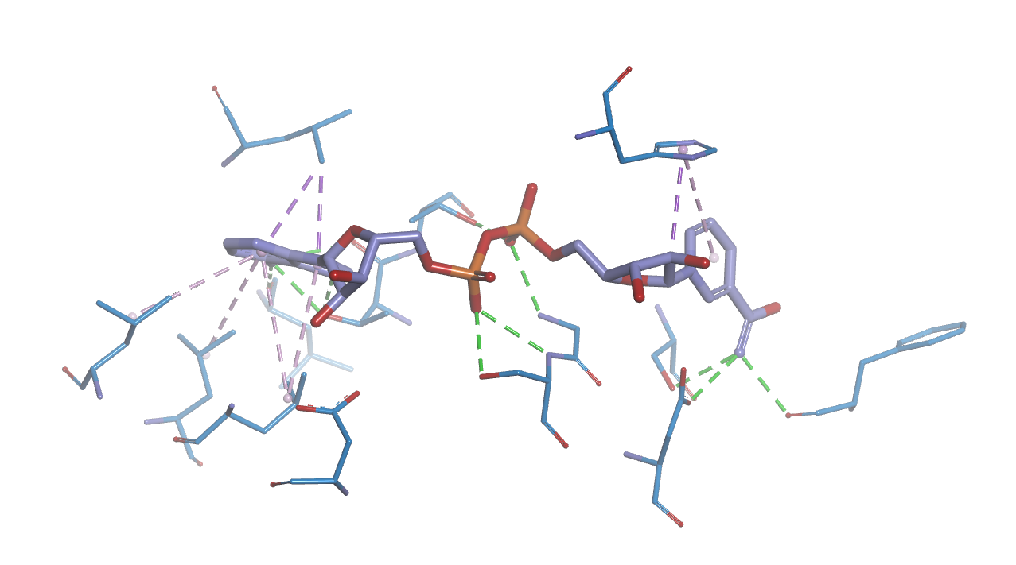
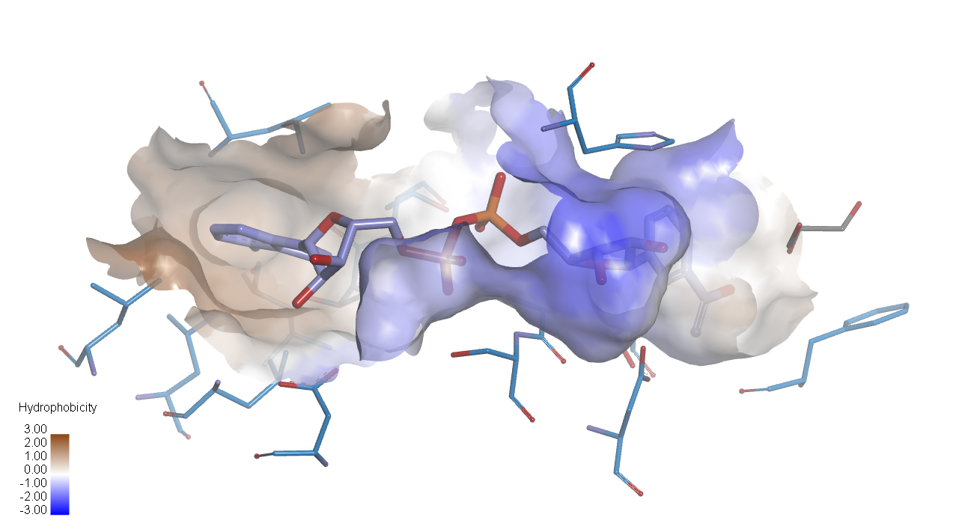
A
C-term. domain
90°
N-term. domain
B
C
L185
H279
T141
L47
T140
G100
S146
L49
S101
F151
L44
D104
Figure S2. Homology model structure of Lxmdh. A. Lxmdh homology model structure represented. NAD⁺-binding region and catalytic pocket are indicated. B. NAD⁺ interaction residues are represented as sticks and hydrogen bonds (green) and hydrophobic (purple) interactions are represented as dotted lines. C. Hydrophobic interaction surface is represented. The color of interaction surface indicates the strength of hydrophobicity.

Slide 3
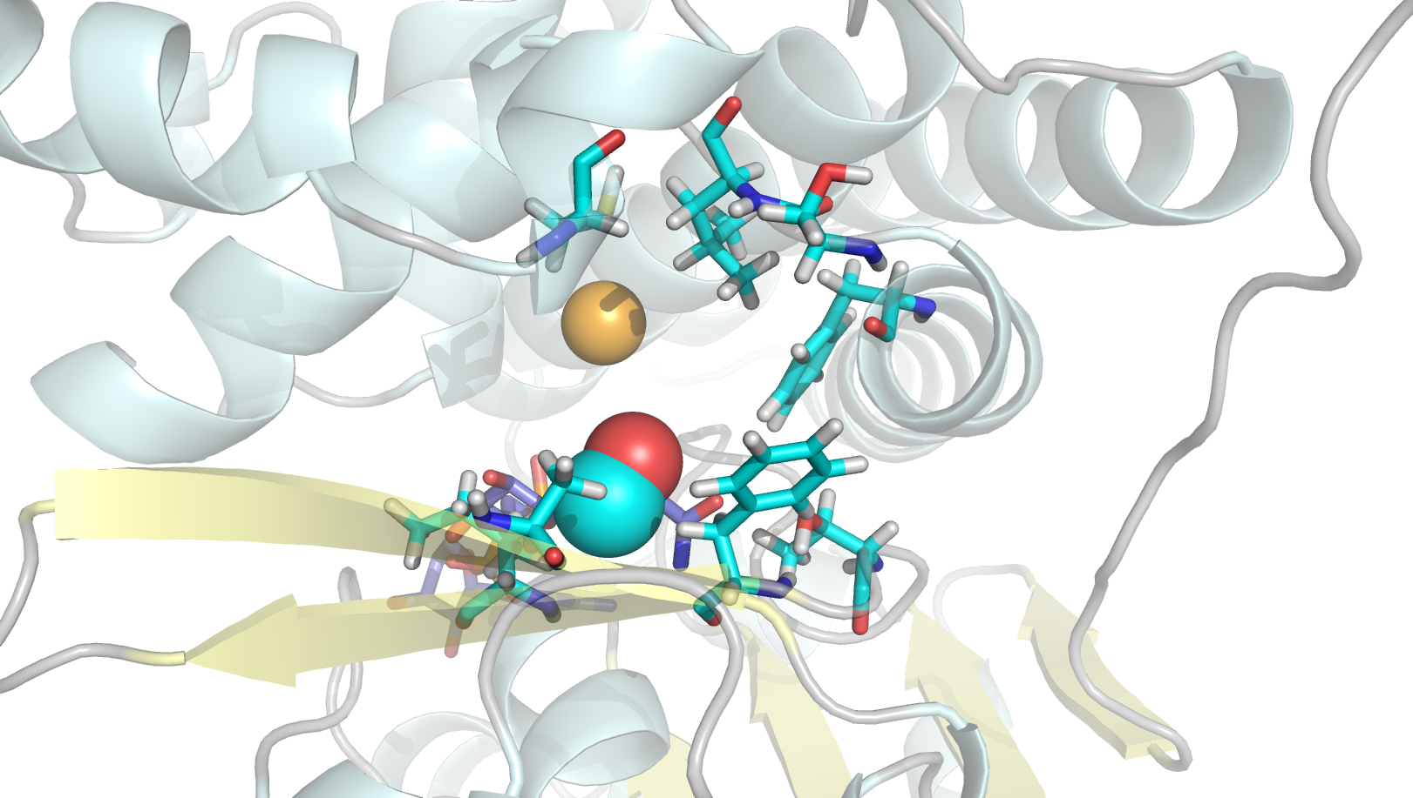
4.5Å
Methanol
Figure S3. Methanol docking model using homology model structure.

Slide 4
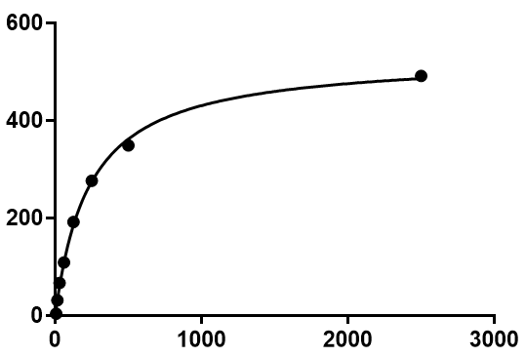
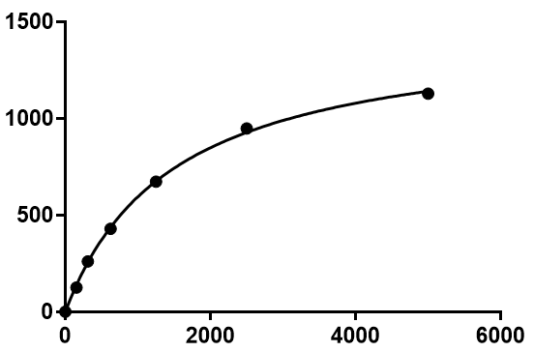
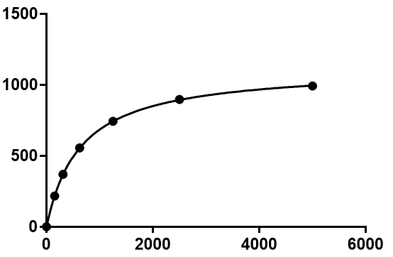
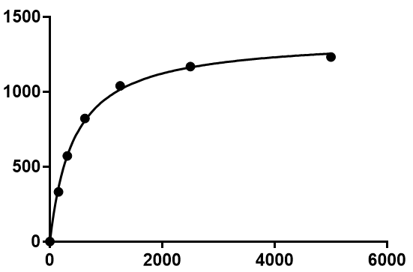
WT-NAD⁺
S101V-NAD⁺
Lxmdh variants | Ethanol (500mM)
 | Vmax (mU/mg) | K_{M} (mM)
WT | 531.2 ± 10.76 | 0.23 ± 0.01
S101V | 1480 ± 28.35 | 1.489 ± 0.07
T141S | 1122 ± 3.24 | 0.64 ± 0.00
A164F | 1362 ± 22.61 | 0.43 ± 0.02
NAD⁺ conc. (μM)
NAD⁺ conc. (μM)
T141S-NAD⁺
A164F-NAD⁺
NAD⁺ conc. (μM)
NAD⁺ conc. (μM)
Figure S4. Kinetic parameters for Lxmdh and mutant variants with NAD⁺

