Slide 1
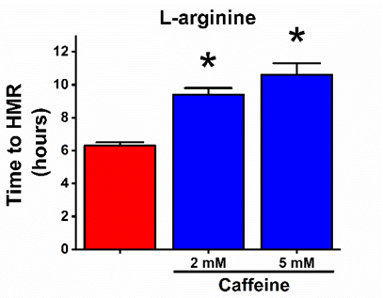
Figure S1
A
B
C
D

Slide 2
Figure S2
A
B
C

Slide 3
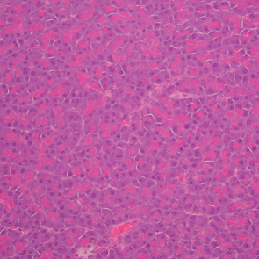
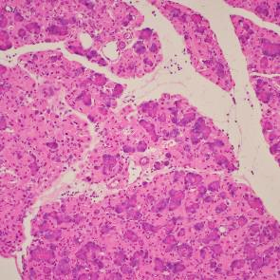
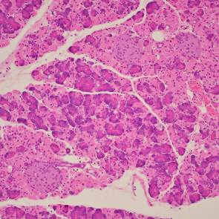
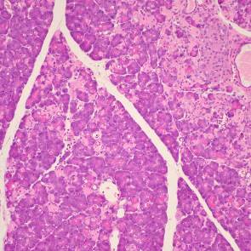
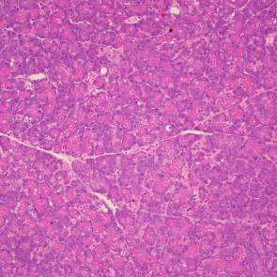
Figure S3
Saline
Wt L-arginine
Ppif^{-/-} L-arginine
Wt L-histidine
Ppif^{-/-} L-histidine
50 μm

Slide 4
Figure S4
A
B
C
D
E

