Slide 1
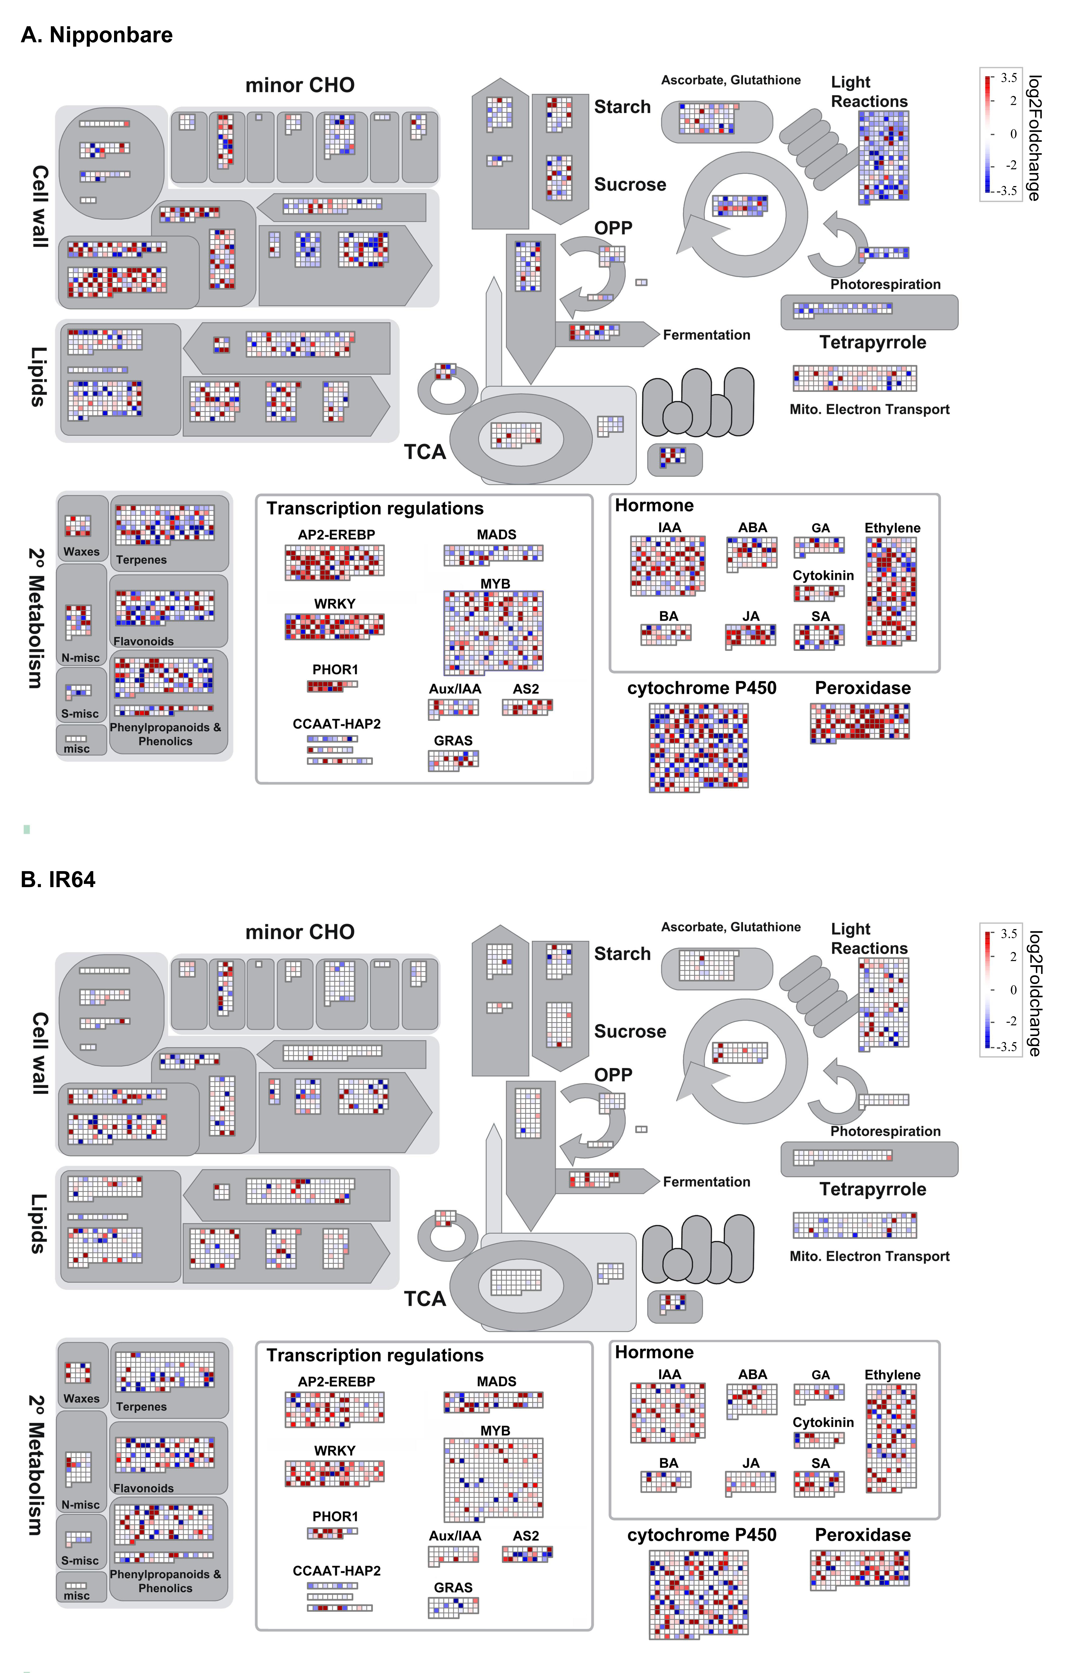
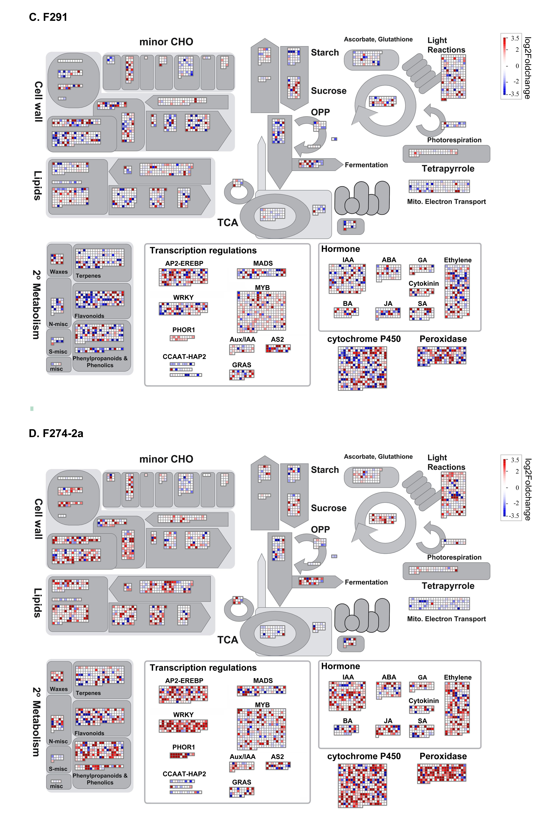
Fig. S4a: Biological pathways responded to submergence in each genotypes

Slide 2
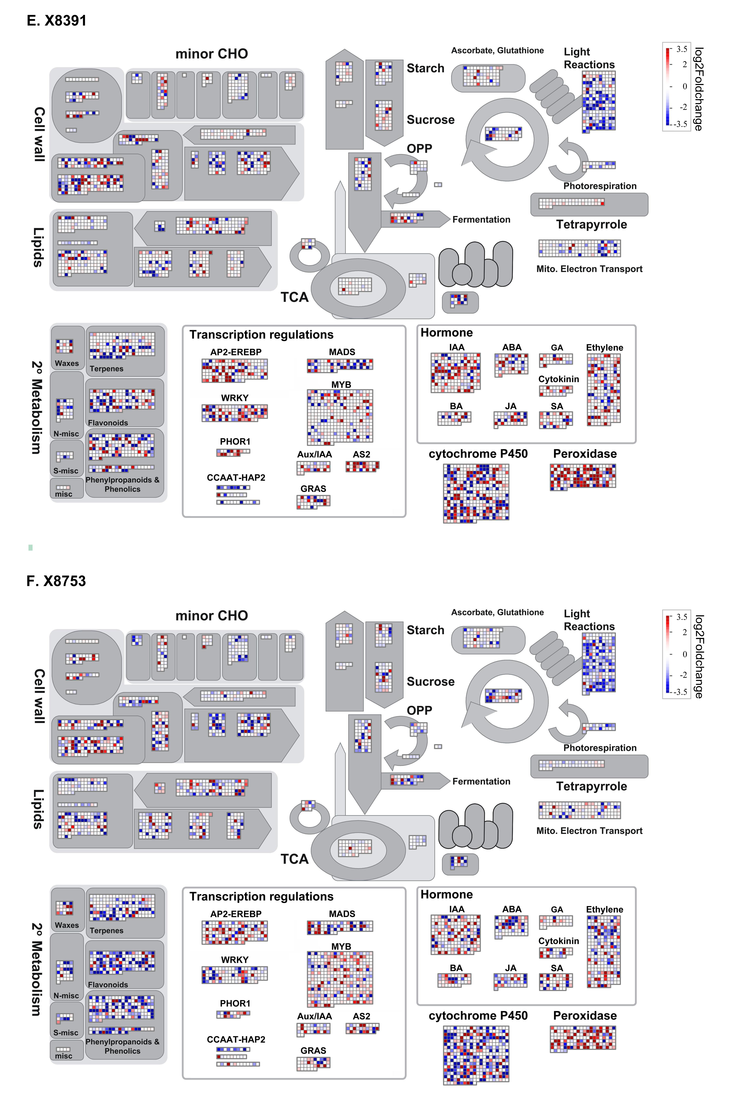
Fig. S4b: Biological pathways responded to submergence in each genotypes

