Slide 1
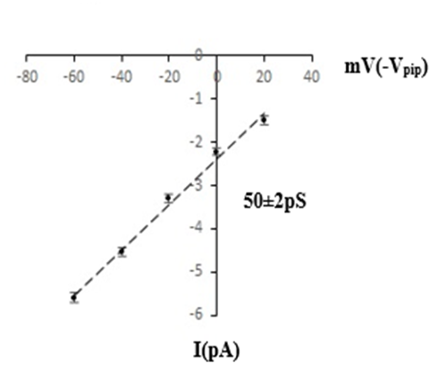
A
B
20mV
c
0mV
c
-20mV
c
-40mV
c
-60mV
c
1s
3pA
Fig. 1

Slide 2
Ba²⁺
Washout
c
2
1
3
60s
1. Control
3pA
c
2. 1 mM Ba²⁺
c
3. Washout
c
1s
3pA
Fig. 2

Slide 3
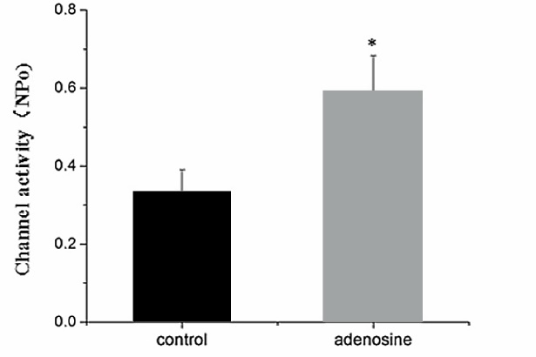
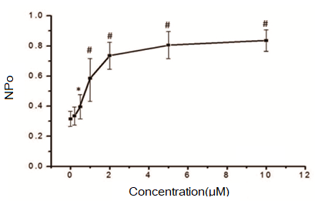
A
B
Adenosine
c
1
2
60s
1. Control
3pA
c
2s
3pA
C
2. Adenosine (1 μM)
c
Fig. 3

Slide 4
A
B
Adenosine
c
1
2
50s
3pA
1. Control
c
1s
3pA
2. Adenosine (1 μM)
c
Fig. 4

Slide 5
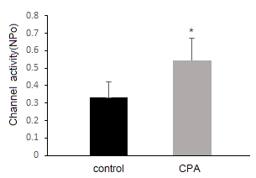
A
B
CPA
c
1
2
60s
1. Control
2pA
c
1s
2. CPA (1 μM)
2pA
c
Fig. 5

Slide 6
A
B
Adenosine
c
1
2
60s
2pA
c
1. Control
1s
2. Adenosine (1 μM)
2pA
c
Fig. 6

Slide 7
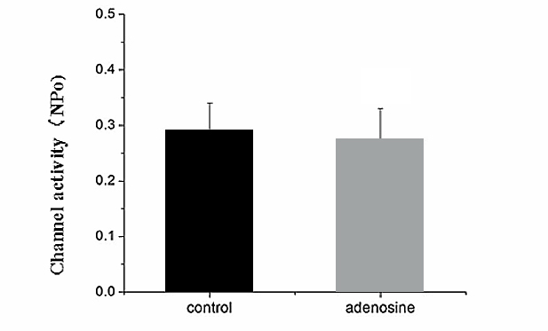
A
B
Adenosine
c
1
2
60s
3pA
1. Control
c
1s
2. Adenosine (1 μM)
3pA
c
Fig. 7

Slide 8
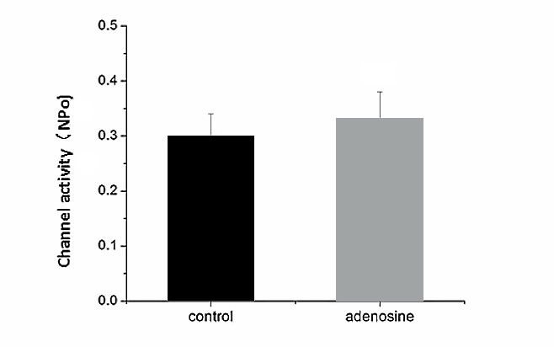
A
A
B
Adenosine
c
1
2
60s
2pA
c
1. Control
1s
2. Adenosine (1 μM)
2pA
c
Fig. 8

Slide 9
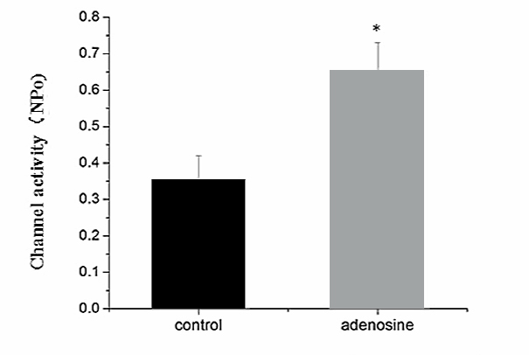
A
B
Adenosine
c
1
2
60s
1. Control
2pA
c
2s
2pA
2. Adenosine (1 μM)
c
Fig. 9

Slide 10
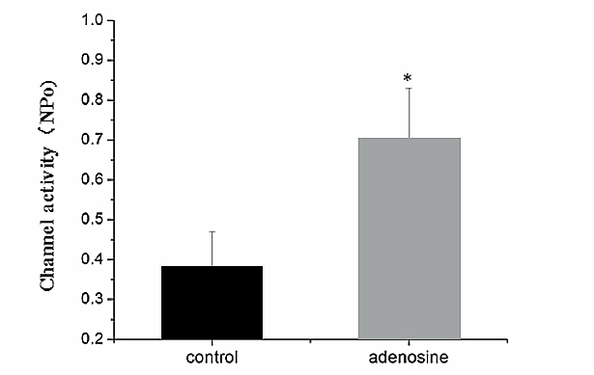
A
B
Adenosine
c
1
2
60s
1. Control
3pA
c
1s
2. Adenosine (1 μM)
3pA
c
Fig. 10

Slide 11
Adenosine
K⁺
K⁺
Na⁺
Kir5.1
Basolateral
Ade-A1
Kir4.2
NBCe1
ATPase
HCO₃⁻
Na⁺
PLC
+
+
+
PKC
+
-V
HCO₃⁻
CA
H₂O + CO₂
Na⁺
pH
+
+
H⁺
Na⁺
NHE3
Apical
Fig. 11

